Slide 1
Unit 16 Chapter 29
THE MONETARY SYSTEM
Role of money
Need for money
Functions of money
Tools of monetary system

Slide 2
THE MEANING OF MONEY
Money: the set of assets in an economy that people regularly use to buy goods and services from other people
Difference between wealth and money
Type of wealth that is regularly accepted by sellers for goods and services
Functions of money
Medium of exchange: an item that buyers give to sellers when they want to purchase goods and services
Unit of account: the yardstick people use to post prices and record debts
Store of value: an item that people can use to transfer purchasing power from the present to the future
Liquidity: the ease with which an asset can be converted into the economy’s medium of exchange

Slide 3
THE KINDS OF MONEY: Indian context
Commodity money: money that takes the form of a commodity with intrinsic value Example: gold and other precious metals
Fiat money: money without intrinsic value that is used as money by government decree Example: currency
Money in the Indian economy (components of money stock)
M0 = Currency in circulation + bank deposits with RBI + other deposits
M1 = Currency with public + demand deposits + other deposits
M2 = M1 +term deposits + certificates of deposits
M3 = M2 + borrowings from financial corporations
The Reserve Bank of India (RBI) as the monetary authority
Regulating and ensuring healthy banking system
Controlling the quantity of money using monetary policy

Slide 4
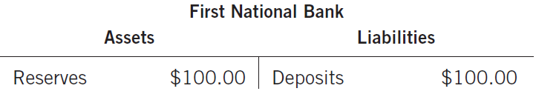
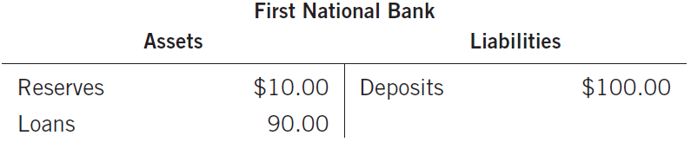
HOW DO BANKS AFFECT MONEY SUPPLY?
100 percent reserve banking
Fractional reserve banking
Money supply increases as once a part of the reserves is lent out

Slide 5
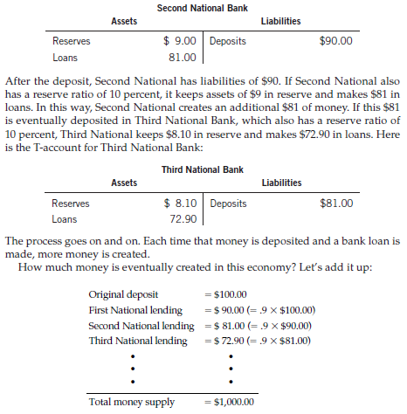
HOW DO BANKS AFFECT MONEY SUPPLY?
Money multiplier: money multiplier the amount of money the banking system generates with each dollar of reserves
Money multiplier is the reciprocal of the reserve ratio

Slide 6
TOOLS OF MONEY CONTROL
Tools on quantity of reserves
Open market operations: purchase and sale of GoI bonds by the RBI
RBI lending to banks: RBI provides loans to commercial banks
Tools on reserves ratios
Cash reserve ratio
Statutory liquidity ratio
Interest of reserves
Problems in controlling money supply
Concerns over inflation and aggregate demand
RBI has no control on how much households can deposit
RBI has no control on how much commercial banks can lend

